Slide 1

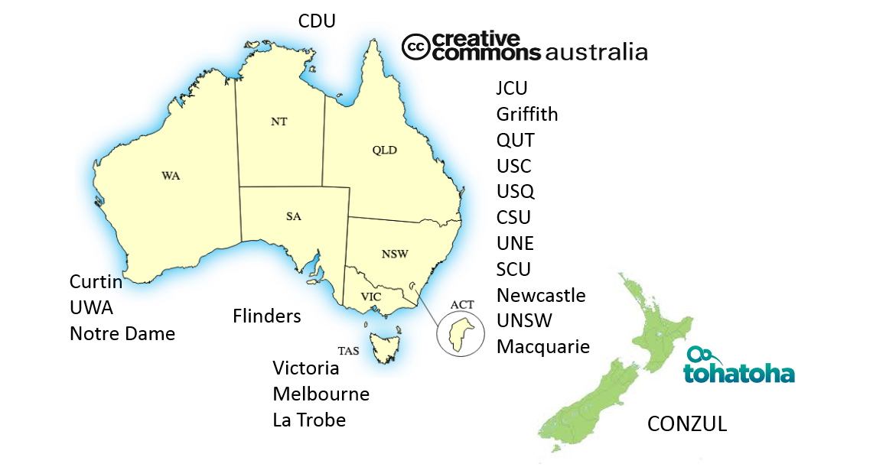

AOASG: who we are
AOASG Executive Committee (elected 2020)
Martin Borchert, UNSW (Chair)
Fiona Burton Macquarie
Donna McRostie, University of Melbourne
Scott Nicholls, UWA
Anne Scott University of Canterbury
Maureen Sullivan, Griffith University
Staff
AOASG Director
Dr Virginia Barbour
Project Officer
Sandra Fry
ECU

Slide 2
ARC and NHMRC (2012/3 and 2016/7): Any Research Output arising from Funded Research must be made Openly Accessible within a twelve month period from the Publication Date. F.A.I.R. Statement (2016) "By 2020, Australian publicly funded researchers and research organisations will have in place policies, standards and practices to: Make publicly funded research outputs findable, accessible, interoperable and reusable.” Productivity Commission (2016) “The Australian, and State and Territory governments should implement an open access policy for publicly-funded research. The policy should provide free and open access arrangements for all publications funded by governments, directly or through university funding, within 12 months of publication. 2017 – the Government accepted this recommendation (but no action thus far…) House of Representatives Standing Committee on Employment, Education & Training (2018) “The Committee recommends that the Australian Government develop a more strategic approach to Australia’s open scholarship environment.”
The foundations of a national approach

Slide 3

We’ve been talking about OA for a while…
CAUL & AOASG
response to Plan S
Au Gov response to Productivity Commission Report
Au House of Reps Inquiry
ANU repository
NZ unis adopt repositories
ARC & NHMRC OA Policies
Revisions to ARC & NHMRC policies
F.A.I.R. statement
CONZUL OA project
Productivity Commission Report
CAUL & AOASG election statement
Au Gov program for university repositories
CAUL Fair, affordable and open program
CAUL &
CONZUL
statements
NHMRC & Chief Scientist Quality initiatives
QUT OA policy
2010 - 2020
2000 - 2010
2020?

Slide 4
Peak/advocacy body
Federal
Government response to Productivity Commission report
Government
House of Reps Inquiry
CAUL & AOASG
response to Plan S
Funder
ANU repository
ASHER – Federal Government program for university repositories
ARC & NHMRC OA Policies
Revisions to ARC & NHMRC policies
F.A.I.R. Working group and statement
Institution
Productivity Commission report
ARDC formed
National Research Infrastructure Roadmap
AOASG
formed
NCRIS funding for data infrastructure
CAUL & AOASG election statement
Brisbane Declaration
on Open Access
CAUL Fair, affordable and open program
CAUL OA
Statement
NHMRC & Chief Scientist research
quality initiatives
QUT OA policy
2010 - 2020
2000 - 2010
2020?

